Slide 1
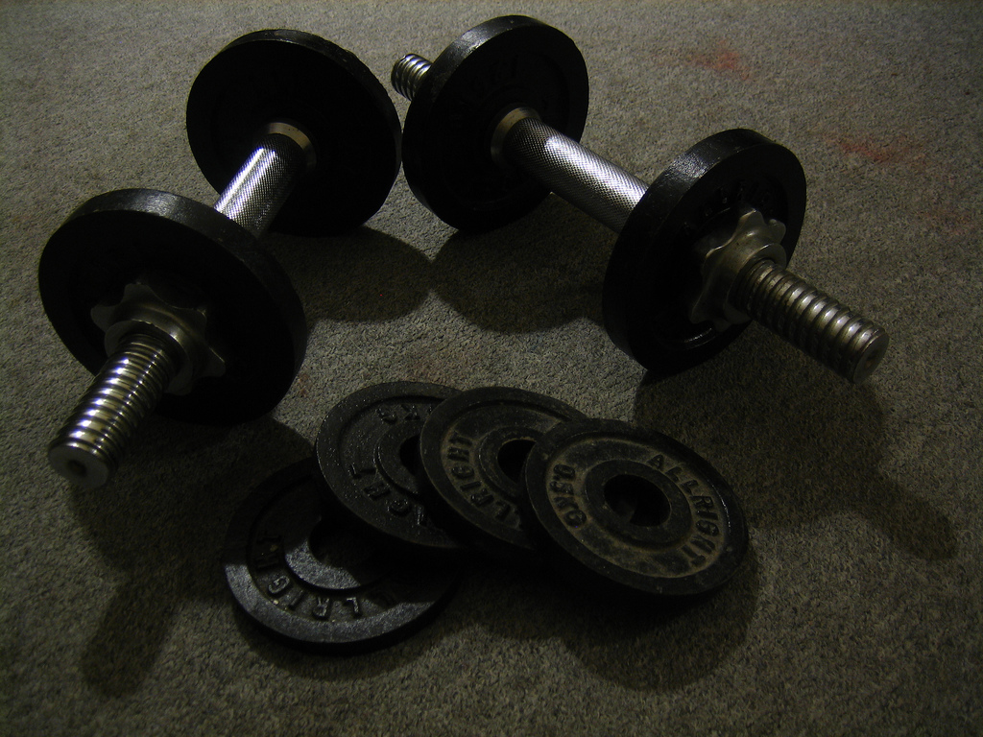
Object Calisthenics
https://www.flickr.com/photos/qubodup/3211594364/in/photolist-5TNg7C-8dd2hH-a9ZBTX-hvy9uT-9GNSA6-9GLBKn

Slide 2
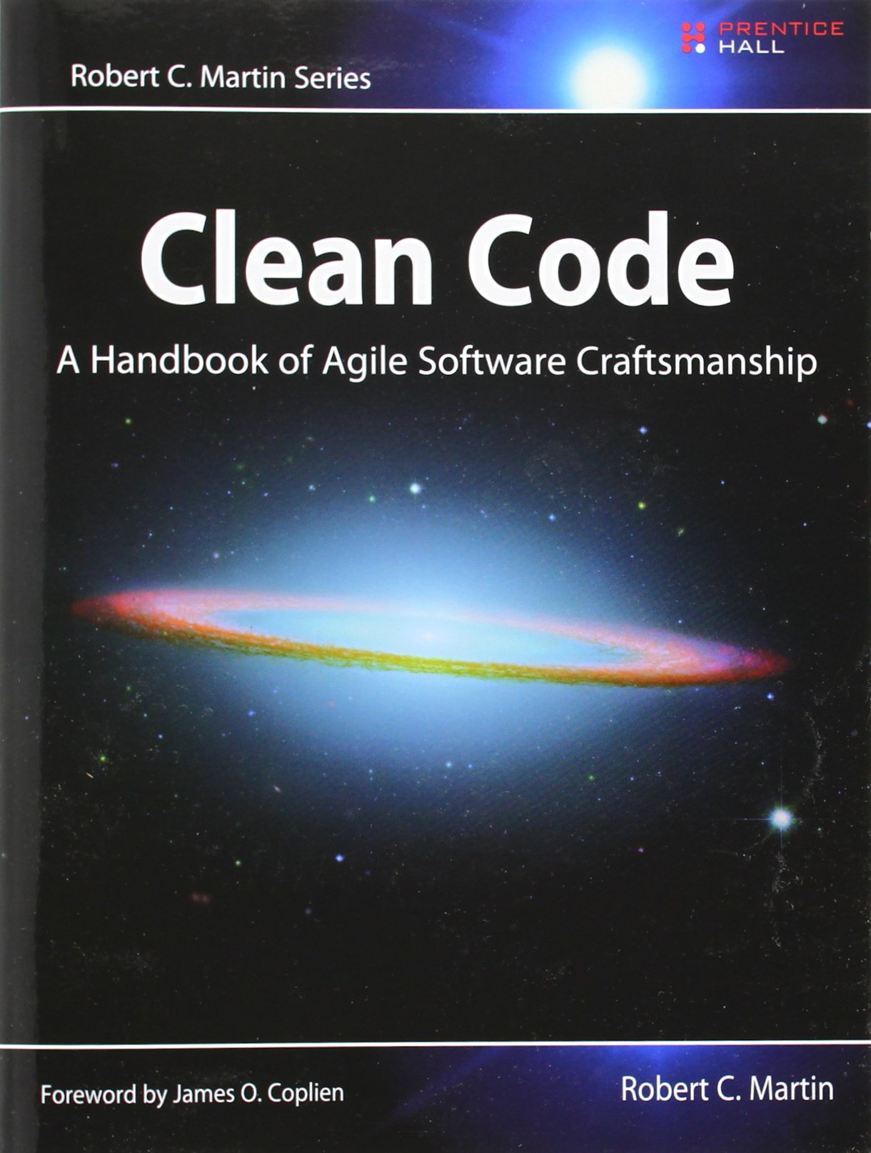
Object Calisthenics
&
Clean Code

Slide 3
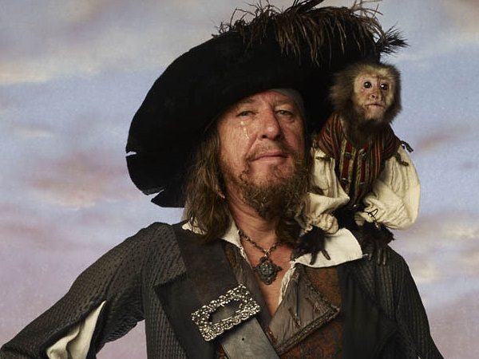
the code is more what you'd call
"guidelines" than actual rules

Slide 4
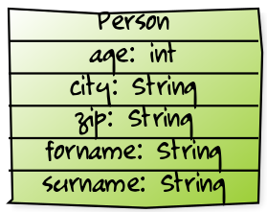
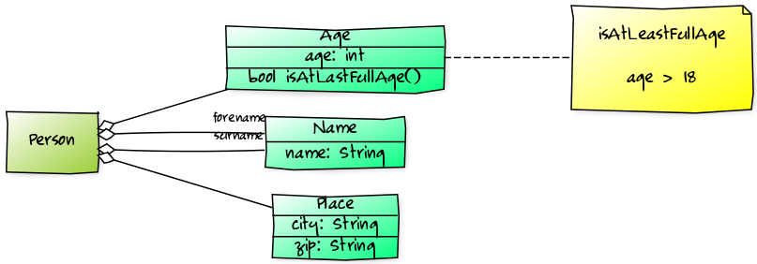
No Primitives (3)

Slide 5


First Class Collections (4)
http://yuml.me/edit/adf6ef65
http://yuml.me/edit/808e68b5
Notes:
[cart|discount:Discount;customer:Customer{bg:green}]<>-cartItems*>[ArrayList{bg:blue}]
[cart|discount:Discount;customer:Customer{bg:green}]<>->cartItems*[CartItems{bg:green}]
[CartItems{bg:blue}]<>->items*[ArrayList{bg:blue}]

